Slide 1
Determining Emotion via User Description: User Study
Markiyan Varhola

Slide 2
Concept / Setup
Derive the general emotion for an image by analyzing the emotion of the person describing it.
Age ranges of subjects:
20-23
24-27
28-30

Slide 3
Experiment Setup
Ask the user for their age
Show user multiple images
Record the response
Analyze the response for emotion
Record the analysis to a file
Generate a graph from the analysis showing the general emotion for the image

Slide 4
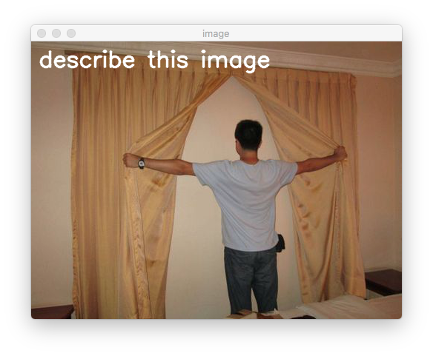
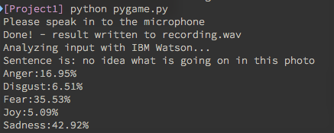
Experiment

Slide 5
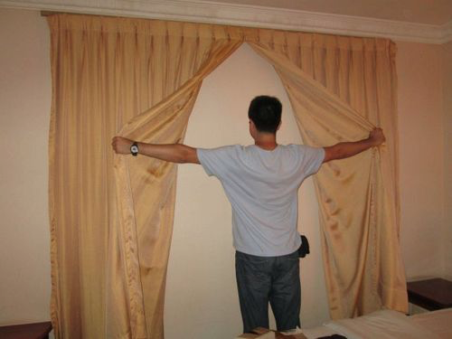

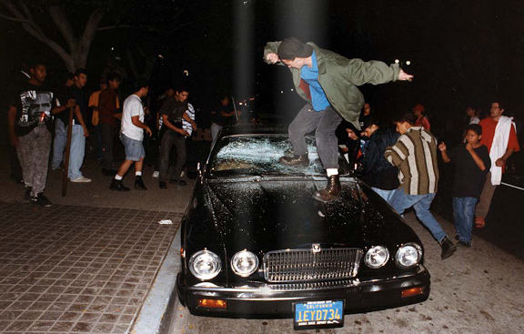
Images

Slide 6
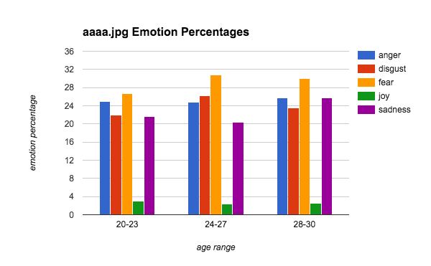
Results

Slide 7
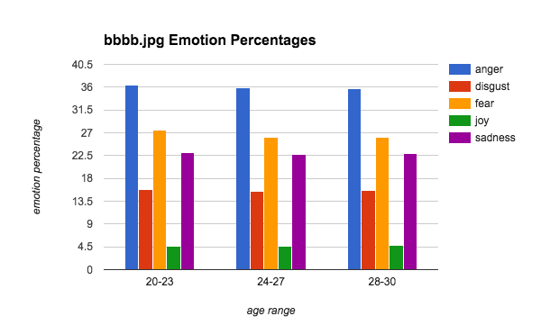
Results

Slide 8
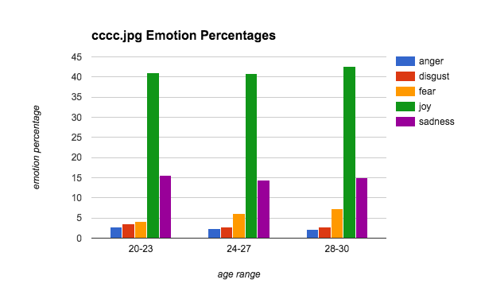
Results

Slide 9
Conclusions
Dominant Emotions:
Anger
Disgust
Fear
Sadness
Dominant Emotions:
Anger
Fear
Sadness
Dominant Emotions:
Joy
Sadness

Slide 10
Conclusions
Age ranges between 20-30 seem to have similar views on the emotion of the images.

Slide 11
Reflex-based Exercise Study Using Gesture Recognition
Markiyan Varhola

Slide 12
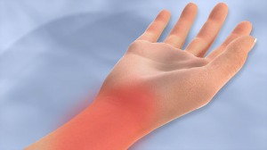
Concept
Computer users often experience hand cramps or pain
Prolonged use can cause health problems such as carpal tunnel syndrome
Can be alleviated by performing regular hand exercise.

Slide 13
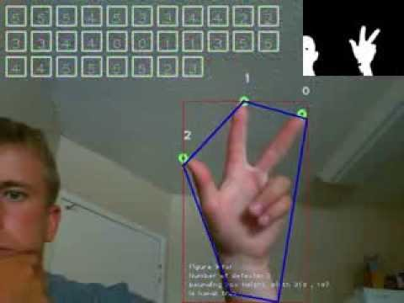
Program
Webcam-based hand gesture recognition
Present the user with an array of fingers to hold up [1,5,2,3,etc.]
The user must complete these tasks as in as little time as possible

Slide 14
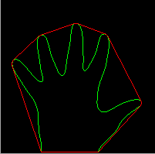
Possible User Study
Give users a warm-up exercise
Then present the user with another exercise
Measure the time difference it takes to complete the first exercise and the second

